Slide 1
Foliar Diseases Detection Using Machine Learning and Deep Learning
KIET GROUP OF INSTITUTIONS
GROUP MEMBERS :-
UMANG PRATAP SINGH
TUSHAR KUNDOO
SAURABH MANDAL
Under the Guidance of
Prof. Shalini Kapoor Mam

Slide 2

Outline
About the project
Technology used
Python Liabraries
Algorithms
Result
Future Scope

Slide 3

About the Project
Foliar diseases are common ailments that affect the leaves of various plants, often caused by fungal or fungal-like organisms. These diseases can have a significant impact on plant health and productivity, making accurate diagnosis crucial for timely treatment and prevention of yield losses. Traditional methods of disease identification rely on labor-intensive field scouting, which can be inefficient and time-consuming. To address this, our project focuses on utilizing deep learning techniques, specifically convolutional neural networks (CNNs), to classify and identify tree diseases. By employing various deep learning and machine learning methods, we aim to determine the most effective approach for disease classification. The project specifically focuses on identifying the most prevalent diseases found in tomato, potato, and pepper plants, encompassing a total of 15 different illnesses. By allowing users to upload leaf images, our system provides real-time disease detection and offers the name of the identified disease, along with recommended pesticides for treatment. In cases where no disease is detected, a message indicating the absence of disease is displayed. Additionally, the system provides information on the proportion of the affected area and suggests suitable pesticides based on the extent of damage. As part of the research, we conducted a survey of various classification methods applicable to plant leaf diseases. The ultimate goal of this project is to contribute to the development of an efficient and user-friendly tool that enables early disease detection, mitigates crop losses, and promotes overall plant health.

Slide 4
Introduction
Plant diseases cause yield reductions that have a direct influence on the domestic and international food production systems and lead to financial losses. About 20% to 40% of the world's food output is lost due to plant diseases and pests, according to the FAO of the United Nations has reported that 13% of global crop yield losses are due to plant diseases. This highlights the importance of identifying and preventing plant diseases to minimize these losses. One method for identifying plant diseases is by analyzing images of plant leaves, using a technique called "image processing" which falls under the field of signal processing. By leveraging the power of artificial intelligence, specifically machine learning, we can extract meaningful information from these images to accurately detect and diagnose plant diseases and thinking performs tasks itself or provides instructions on how to carry them out.

Slide 5

Technology used: >Machine Learning >CNN(Convolutional Neural Network) >Deep Learning >Image Recognition

Slide 6
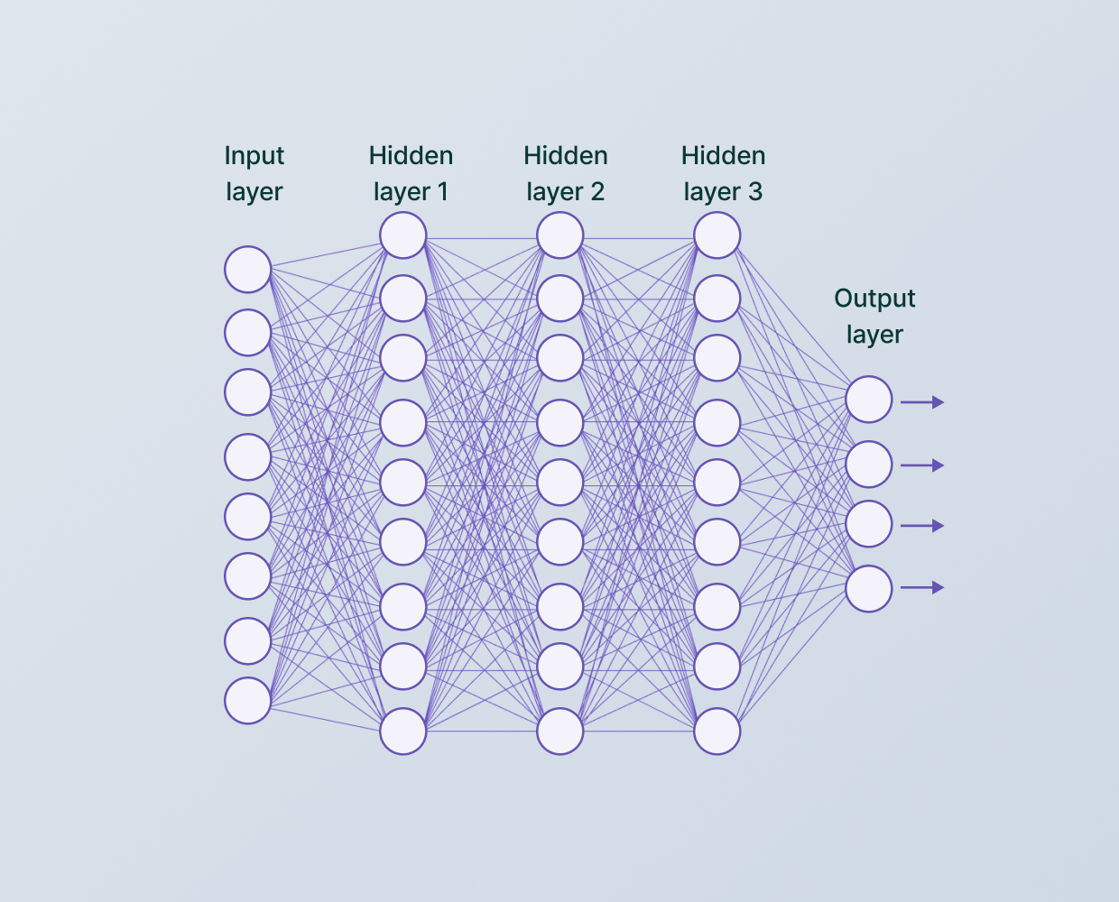
CNN(convolutional Neural Network) A convolutional neural network (CNN) is a type of artificial neural network used in image recognition and processing that is specifically designed to process pixel data. CNNs are powerful image processing, artificial intelligence (AI) that use deep learning to perform both generative and descriptive tasks, often using machine vison that includes image and video recognition, along with recommender systems and natural language processing (NLP). A neural network is a system of hardware and/or software patterned after the operation of neurons in the human brain. Traditional neural networks are not ideal for image processing and must be fed images in reduced-resolution pieces.

Slide 7
DEEP LEARNING Deep learning is a subfield of machine learning concerned with algorithms inspired by the structure and function of the brain called artificial neural network (ANN). It has networks capable of learning unsupervised or unstructured data. Deep learning is often known as deep neural learning or deep neural network. Deep learning is a subfield of machine learning concerned with algorithms inspired by the structure and function of the brain called artificial neural network (ANN). It has networks capable of learning unsupervised or unstructured data. Deep learning is often known as deep neural learning or deep neural network.

Slide 8
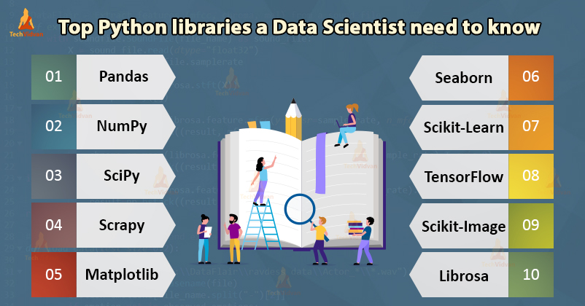
Python Libraries
Python’s standard library is very extensive, offering a wide range of facilities as indicated by the long table of contents listed below. The library contains built-in modules (written in C) that provide access to system functionality such as file I/O that would otherwise be inaccessible to Python programmers, as well as modules written in Python that provide standardized solutions for many problems that occur in everyday programming. Some of these modules are explicitly designed to encourage and enhance the portability of Python programs by abstracting away platform-specifics into platform-neutral APIs.
Ex-Numpy,Pandas,Tenserflow,Scipy,Shutil,natsort.

Slide 9
Thinkter
Python offers multiple options for developing GUI (Graphical User Interface). Out of all the GUI methods, tkinter is the most commonly used method. It is a standard Python interface to the Tk GUI toolkit shipped with Python. Python with tkinter is the fastest and easiest way to create the GUI applications. Creating a GUI using tkinter is an easy task.
Tkinter is the standard GUI library for Python. Python when combined with Tkinter provides a fast and easy way to create GUI applications. Tkinter provides a powerful object-oriented interface to the Tk GUI toolkit.
Developing desktop based applications with python Tkinter is not a complex task. An empty Tkinter top-level window can be created by using the following steps.
import the Tkinter module.
Create the main application window.
Add the widgets like labels, buttons, frames, etc. to the window.
Call the main event loop so that the actions can take place on the user's computer screen.

Slide 10
Thinkter Filedialog
Python Tkinter (and TK) offer a set of dialogs that you can use when working with files. By using these you don’t have to design standard dialogs your self. Example dialogs include an open file dialog, a save file dialog and many others. Besides file dialogs there are other standard dialogs, but in this article we will focus on file dialogs.
File dialogs help you open, save files or directories. This is the type of dialog you get when you click file,open. This dialog comes out of the module, there’s no need to write all the code manually.
Tkinter does not have a native looking file dialog, instead it has the customer tk style. You can see these below.

Slide 11
CV2
OpenCV-Python is a library of Python bindings designed to solve computer vision problems. cv2.imread() method loads an image from the specified file. If the image cannot be read (because of missing file, improper permissions, unsupported or invalid format) then this method returns an empty matrix.
Syntax: cv2.imread(path, flag)
Parameters: path: A string representing the path of the image to be read. flag: It specifies the way in which image should be read. It’s default value is cv2.IMREAD_COLOR
Return Value: This method returns an image that is loaded from the specified file.

Slide 12

Scikit-learn
Scikit-learn (Sklearn) is the most useful and robust library for machine learning in Python. It provides a selection of efficient tools for machine learning and statistical modeling including classification, regression, clustering and dimensionality reduction via a consistence interface in Python. This library, which is largely written in Python, is built upon NumPy, SciPy and Matplotlib.

Slide 13
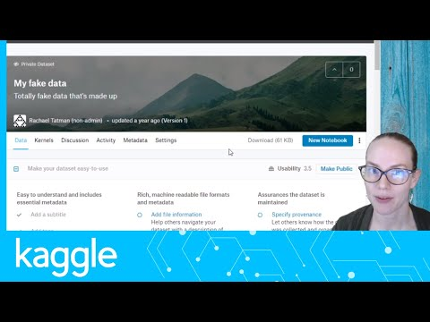
Different Datasets From Kaggle
1.A dataset, or data set, is simply a collection of data.
2. The simplest and most common format for datasets you’ll find online is a spreadsheet or CSV format — a single file organized as a table of rows and columns. But some datasets will be stored in other formats, and they don’t have to be just one file. Sometimes a dataset may be a zip file or folder containing multiple data tables with related data.

Slide 14
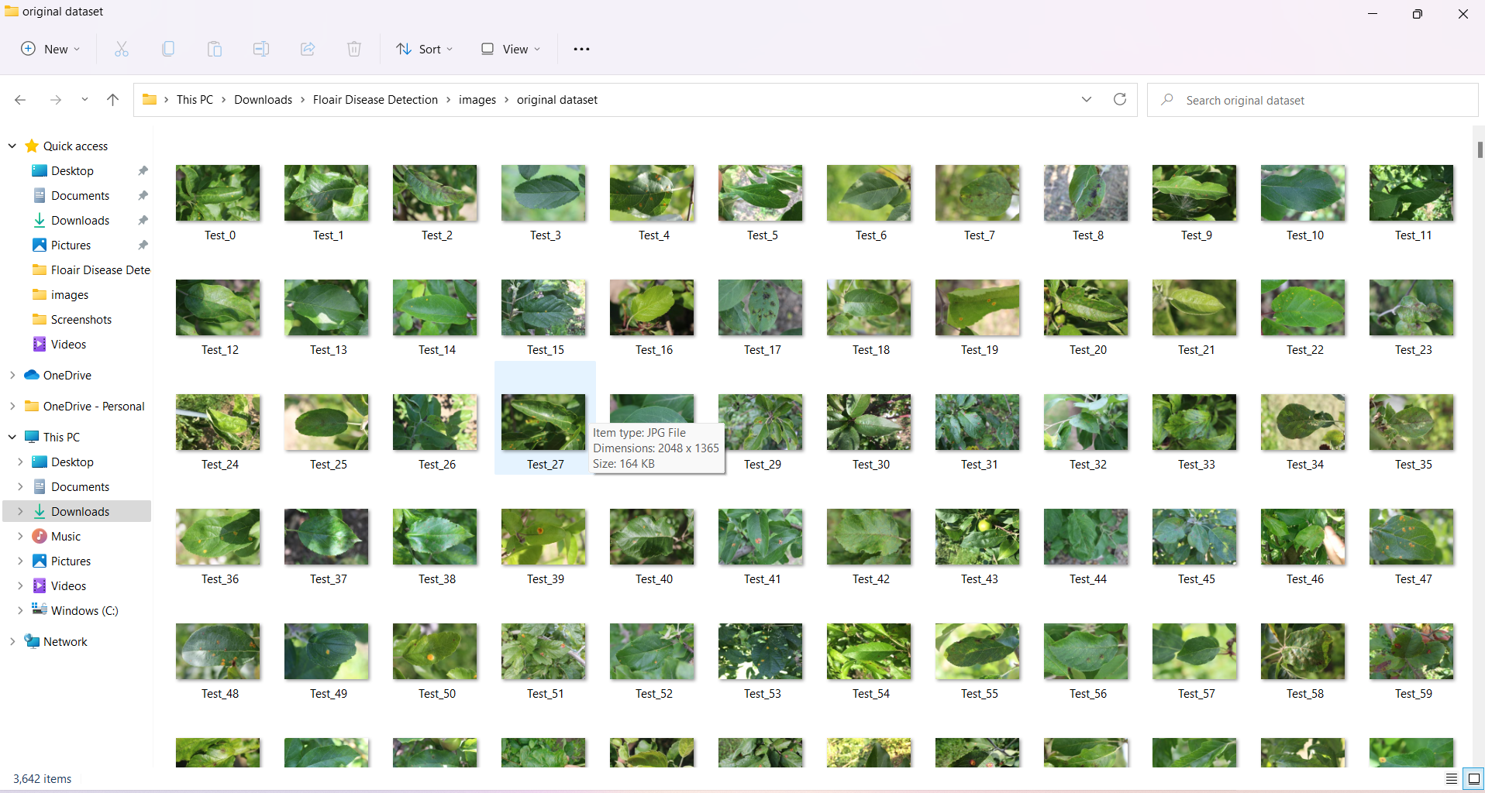
Examples from Dataset

Slide 15
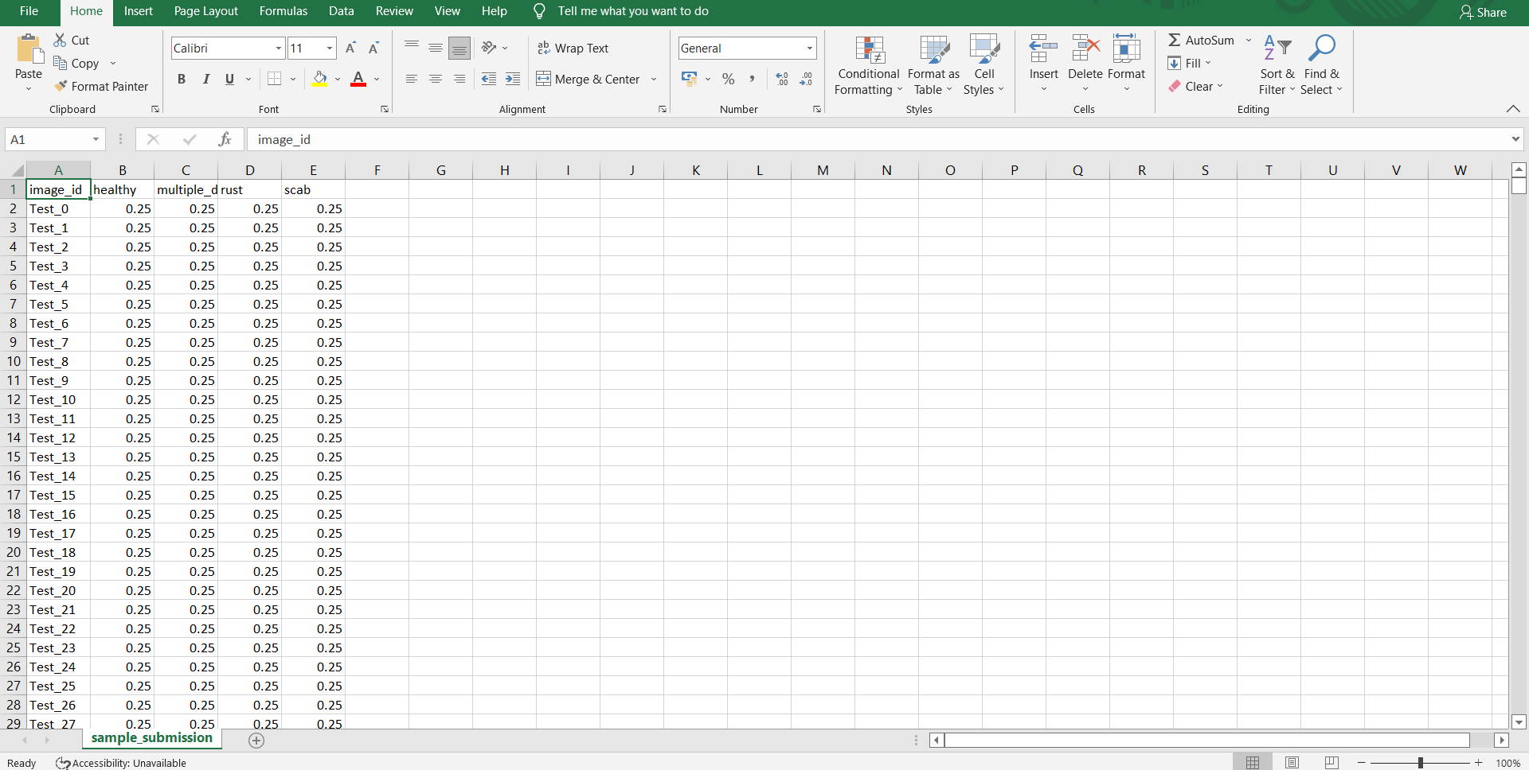
CSV DATASET

Slide 16
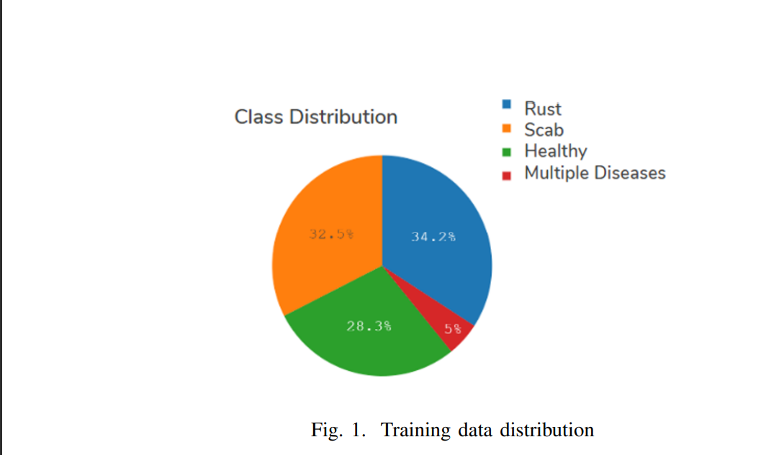
Training data distribution Our model try to classify that the leaf falls one of the given category of the dataset includes Rust,Scab,Healthy,Multiple Diseases.

Slide 17
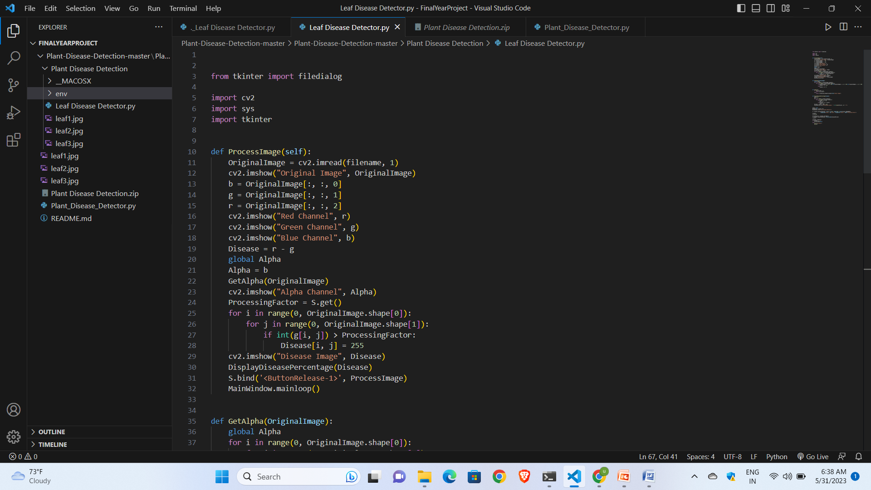
Examples of code Snippets

Slide 18
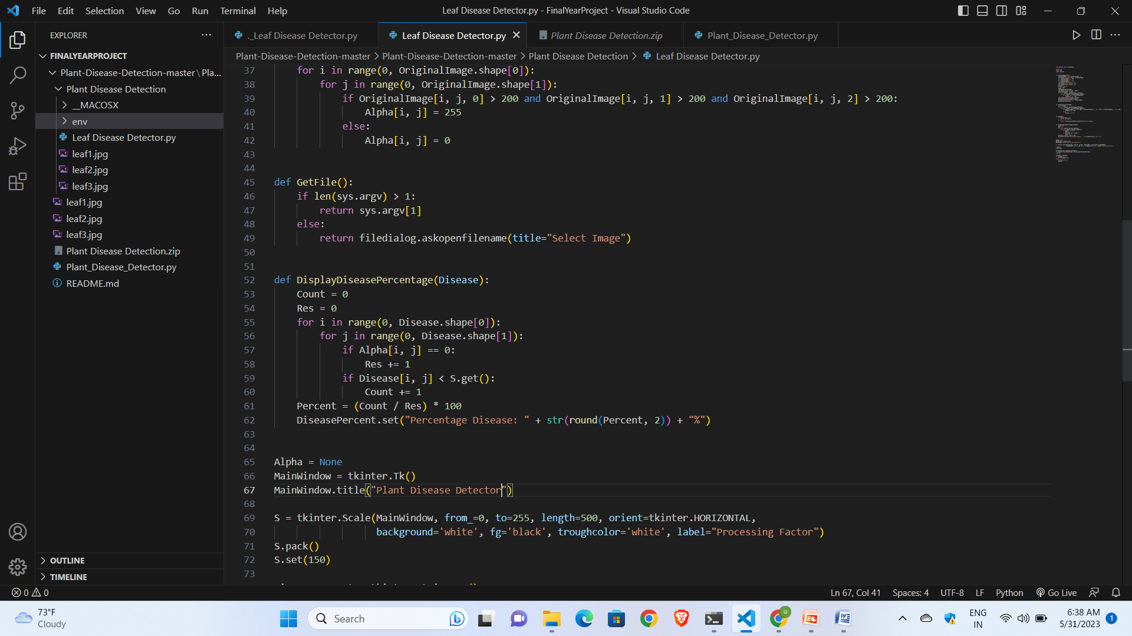

Slide 19
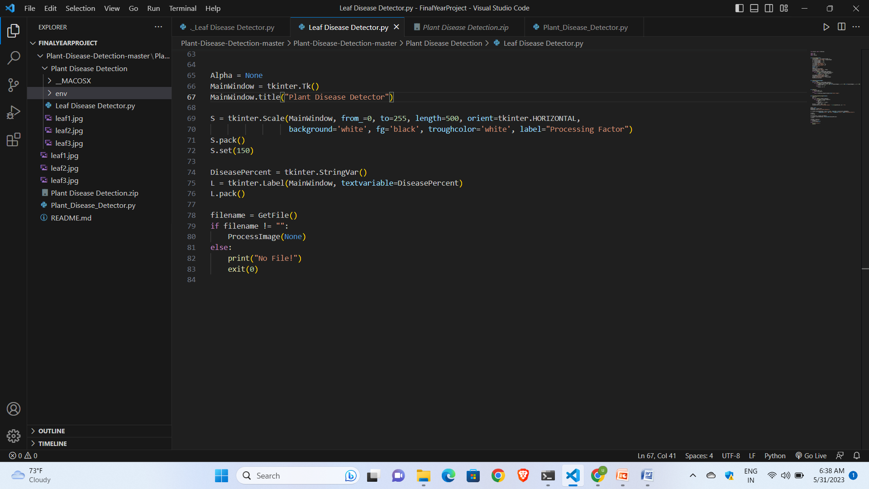

Slide 20
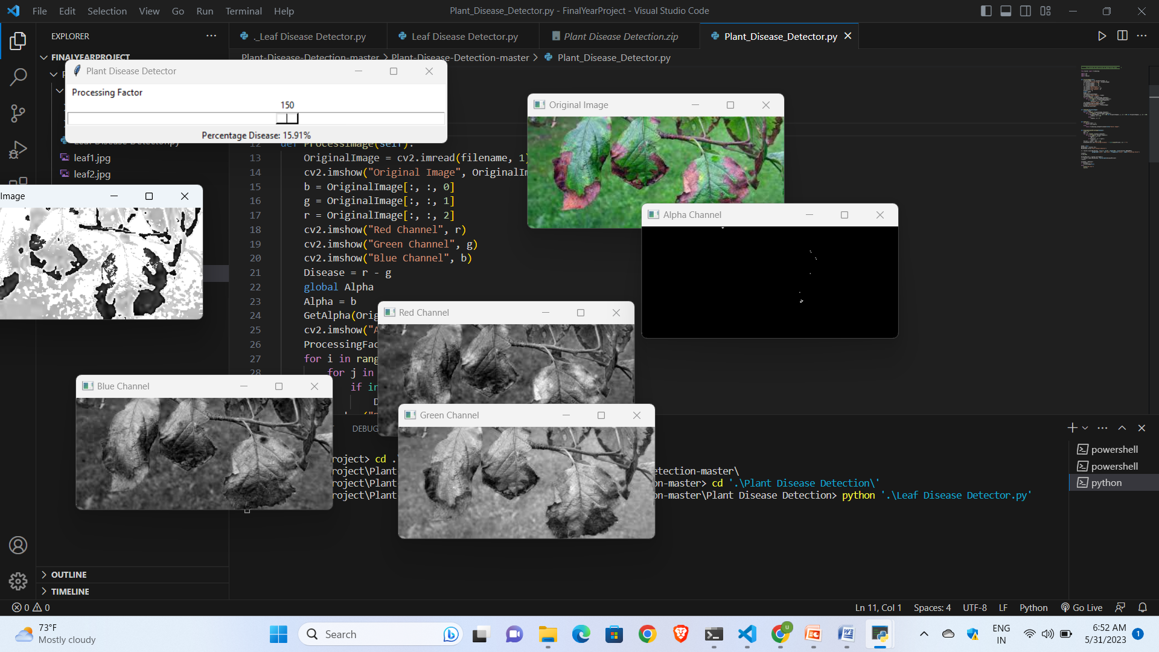
Result

Slide 21
Introduction to Result With the hope of increasing accuracy, the CNN (Alexnet) is being tested for the detection of leaf diseases. The database is split into two datasets, training and testing, using an 80/20 splitting ratio. CNN determines if a leaf is healthy or ill, and if so, it also forecasts the type of sickness. The CNN model was trained using a 10-epoch starting learning rate of 0.001. The activit of the CNN model on the testing dataset during training. Apple leaf confusion matrix illustration. 99% of the time, Apples leaves are accurate. Table 1 provides a summary of each plant's categorization accuracy. The total degree of accuracy is 97.71%. Examples of categorization made using convolutional neural networks on some randomly chosen photos from the testing dataset. The upper right corner of each image shows the accuracy percentage for the related plant leaves. By allowing for the early diagnosis of illnesses, this effort will help in the automatic identification of plant leaf disease and boost agricultural productivity. The accuracy of detecting tomato leaf disease may be improved by evaluating transfer learning and other CNN models.

Slide 22
Future Scope This project will be very helpful to farmers in rural areasand also will help them in saving their yields from diseases as farmers lose a huge amount of their cultivated crops because of diseases and this system will help them to avoid the similar situation.Also we have tried to implement this project in a regional language so a stomake things more understandable for farmers. Here are some points you can include: IMPROVED MODELS AND ALGORITHMS Explore advanced deep learning architectures specifically designed for plant disease detection, such as attention-based models or graph convolutional networks.Investigate the use of generative models, such as generative adversarial networks (GANs), for synthetic image generation and data augmentation in limited datasets.Research novel algorithms that can handle multi-class or multi-label classification for detecting multiple diseases in a single plant leaf.

Slide 23
TRANSFER LEARNING AND MODEL GENERALIZATION Investigate the effectiveness of transfer learning by fine-tuning pre-trained models trained on large-scale image datasets, such as ImageNet, for foliar disease detection tasks. Explore methods to improve the generalization capabilities of disease detection models, allowing them to perform well on unseen plant species or disease variations. REAL-TIME AND ON-DEVICE DISEASE DETECTION Develop lightweight and efficient models suitable for deployment on edge devices, such as smartphones or low-power embedded systems, to enable real-time disease detection in the field.Investigate techniques like model compression, quantization, and knowledge distillation to reduce the model size and computational requirements while maintaining accuracy.

Slide 24
THANK YOU

